Slide 1
” FORECASTING OF SMART CITY TRAFFIC PATTERNS”
CAPSTONE PROJECT
Presented By:
Name- Jayvanti Palwe
College Name-Dhole Patil College Of Engineering
Branch- E&TC

Slide 2
OUTLINE
Problem Statement
Proposed System/Solution
System Development Approach
Algorithm & Deployment
Result
Conclusion
Future Scope
References

Slide 3
Problem Statement
The project aims to analyze and predict traffic patterns in a smart city using advanced data science techniques. The goal is to develop a predictive model capable of accurately forecasting traffic congestion at various city junctions, thereby aiding in improved traffic management and reducing congestion. With rapid urbanization and an increasing number of vehicles on the roads, traffic congestion has become a significant challenge for city planners and administrators. Traditional traffic management systems, which rely on static and historical data, often fall short in addressing the dynamic nature of urban traffic. Consequently, there is a pressing need for innovative solutions that leverage real-time data and advanced analytics to predict and manage traffic flow more effectively.
Detailed Explanation: The specific objectives of this project are to:
1. Understand Traffic Patterns: - Collect and analyze traffic data from multiple junctions within the city. - Identify the factors influencing traffic flow, such as time of day, day of the week, and special events. - Examine historical traffic data to discern patterns and trends that can inform predictive models.
2. Data Preprocessing: - Handle missing or null values in the dataset to ensure the accuracy and reliability of the data. - Transform datetime information into meaningful features such as day, month, year, and hour to capture temporal patterns. - Clean the data to remove any inconsistencies or anomalies that could skew the analysis.
3. Exploratory Data Analysis (EDA): - Visualize the traffic data using histograms, time-series plots, count plots, and scatter plots to gain insights into traffic behavior.

Slide 4
Determine peak traffic hours and analyze variations in traffic volume across different junctions and times.
Identify correlations between different variables to inform the development of predictive models.
4. Model Development: - Train various machine learning models, starting with linear regression to establish a baseline performance.
- Explore more advanced models such as Light Gradient Boosting Machine (LGBM) and Random Forest
improve predictive accuracy.
- Evaluate model performance using metrics like Mean Absolute Error (MAE), Mean Squared Error (MSE), and
R-squared (R²) to select the best model for traffic prediction.
Needs and Significance: The need for this project arises from the increasing challenges posed by urban traffic congestion. Efficient traffic management is crucial for several reasons:
Reducing Commuter Stress:
- Traffic congestion leads to longer travel times, increased fuel consumption, and heightened stress commuter.
-By predicting and managing traffic flow, the project aims to alleviate these issues and enhance the overall
commuting experience

Slide 5
2. Environmental Impact: - Congested traffic contributes to higher emissions of greenhouse gases and pollutants. Efficient traffic management can help reduce the environmental footprint of urban transportation by minimizing idle times and optimizing routes.
3. Economic Benefits: - Traffic congestion has significant economic costs, including lost productivity, increased transportation costs, and delays in goods and services delivery. Improving traffic flow can enhance economic efficiency and productivity.
4. Safety: - High traffic congestion is often associated with an increased risk of accidents. By predicting traffic patterns and managing congestion, the project can contribute to safer road conditions and reduce the likelihood of traffic accidents.
5. Urban Planning: - Data-driven insights from the project can inform urban planning and infrastructure development. City planners can use the predictions to design better road networks, optimize traffic signal timings, and plan for future transportation needs. In summary, this project addresses a critical urban challenge by leveraging data science to develop a smart traffic management solution. The predictive model aims to enhance traffic flow, reduce congestion, and contribute to the development of more efficient and sustainable urban transportation systems.

Slide 6
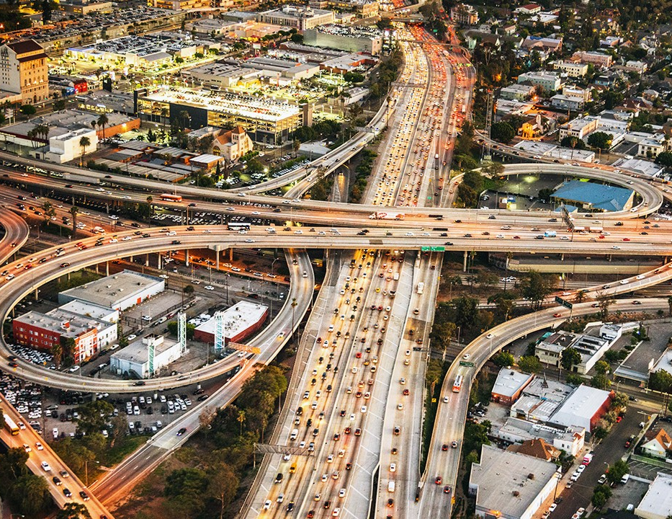
Model Development: -
Most importantly, we wanted to ensure that the list represented not only ways to improve city living and urban efficiency, but that also demonstrated a commitment to the greater good, on a global scale. - Train various machine learning models, starting with linear regression to establish a baseline performance.

Slide 7
Proposed Solution
To address these limitations, my project focuses on leveraging Light Gradient Boosting Machine (LGBM) and Random Forest models for traffic pattern prediction. These models offer a balance between accuracy, computational efficiency, and scalability.
1 Model Selection: - LGBM (Light Gradient Boosting Machine): This model is known for its high efficiency and accuracy in handling large datasets. It builds multiple decision trees sequentially, improving the model's performance with each iteration.
- Random Forest: This model is robust and can handle large datasets with high dimensionality. It creates an ensemble of decision trees, providing more accurate and stable predictions compared to single decision tree models.
2 Value Addition: - Efficiency and Speed: LGBM and Random Forest models are faster to train and deploy compared to deep learning models, making them suitable for real-time applications.
- Interpretability: These models provide better interpretability, allowing city planners and traffic managers to understand the factors influencing traffic patterns and make informed decisions.
- Scalability: Both models can efficiently handle increasing data volumes and complexity, ensuring scalability to larger urban environments.

Slide 8
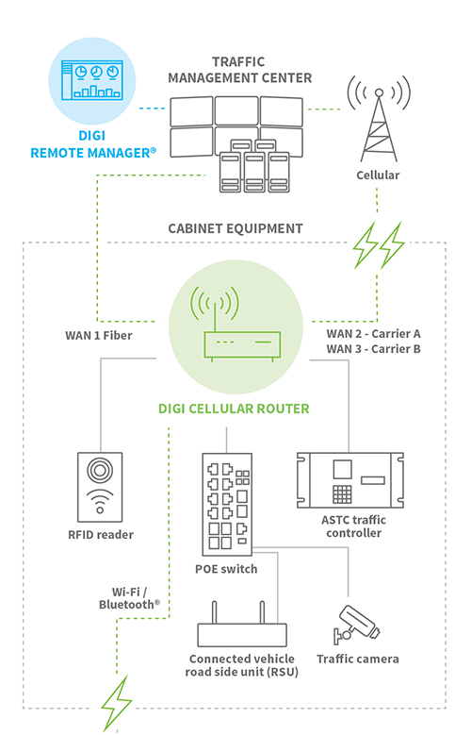
System Approach
In the realm of smart city traffic forecasting, adopting a systematic approach is crucial for comprehensively analyzing and predicting traffic patterns. This approach involves integrating various components and factors that influence traffic dynamics within a city environment. Here’s how each element contributes to the system:
Data Collection and Integration: Gathering real-time and historical data from diverse sources such as traffic sensors, GPS devices, public transportation systems, and weather reports. Integration of this data provides a holistic view of traffic conditions.
Data Processing and Analysis: Utilizing advanced analytics techniques including machine learning algorithms, statistical models, and data visualization tools to process and analyze the collected data. This step identifies patterns, trends, and anomalies within the traffic data.
Predictive Modeling: Developing predictive models based on the analyzed data to forecast future traffic patterns. These models incorporate factors such as time of day, day of the week, special events, weather conditions, and historical traffic data.

Slide 9
Algorithm & Deployment
Algorithm Selection:
Machine Learning Techniques: Utilizing machine learning algorithms such as supervised learning (e.g., regression, classification), unsupervised learning (e.g., clustering), and reinforcement learning to extract patterns from historical traffic data.
Statistical Models: Employing statistical models like time series analysis, spatial analysis, and Bayesian inference to capture trends and correlations in traffic patterns.
Simulation and Optimization: Integrating simulation models and optimization algorithms to simulate traffic scenarios and optimize traffic flow based on predicted patterns.
Data Preprocessing:
Feature Engineering: Extracting relevant features from raw data sources such as traffic volume, speed, historical patterns, weather conditions, and special events.
Normalization and Scaling: Preprocessing data to ensure consistency and compatibility across different datasets and input variables.

Slide 10
Deployment in Real-Time:
Real-Time Data Integration: Implementing mechanisms to ingest and process real-time data from traffic sensors, GPS devices, and other sources.
scalability and Efficiency: Ensuring algorithms are deployed in a scalable and efficient manner to handle the dynamic nature of traffic data in a smart city environment.
Integration with Decision Support Systems: Integrating forecasting models with decision support systems used by city planners, transportation authorities, and emergency services to enhance operational efficiency and responsiveness
Visualization and Reporting:
Visualizing Predictions: Generating visualizations such as maps, graphs, and dashboards to communicate forecasted traffic patterns effectively.
Reporting: Providing comprehensive reports and insights derived from the forecasting models to stakeholders and decision-makers.

Slide 11
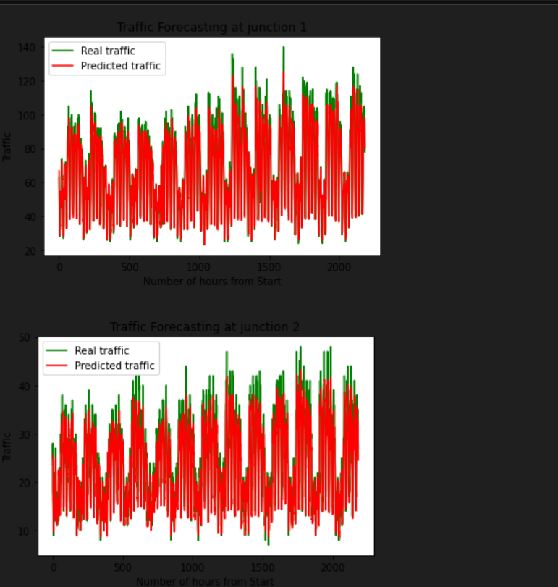
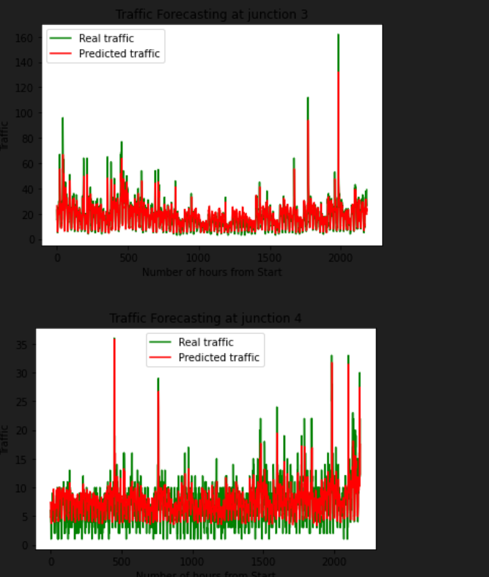
RESULT

Slide 12
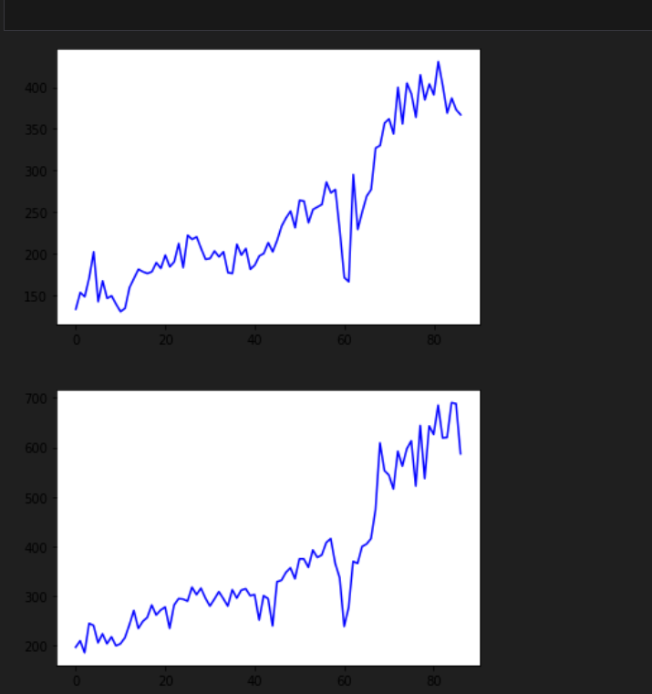
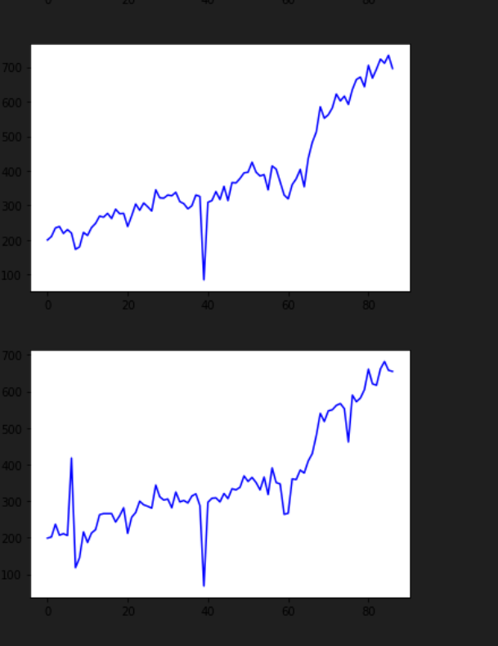

Slide 13
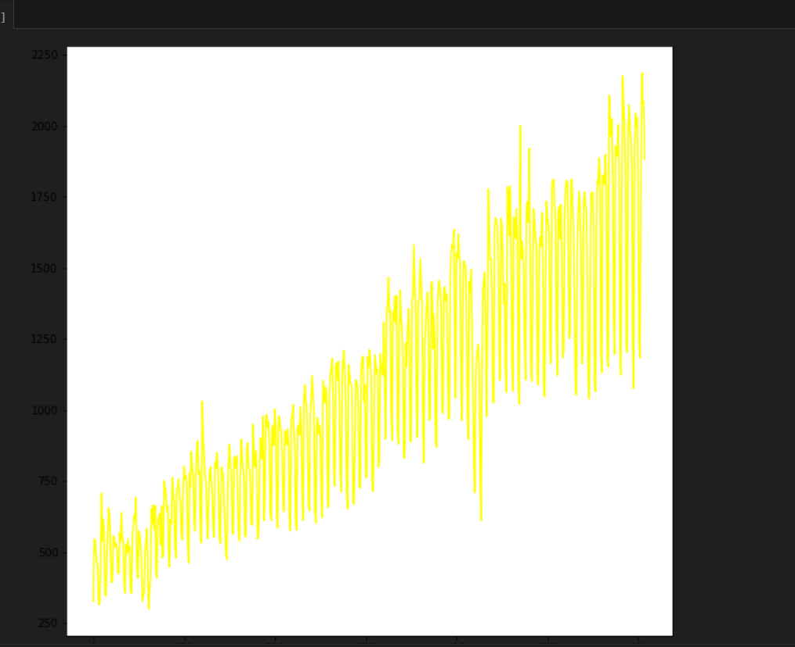
OUTPUT

Slide 14
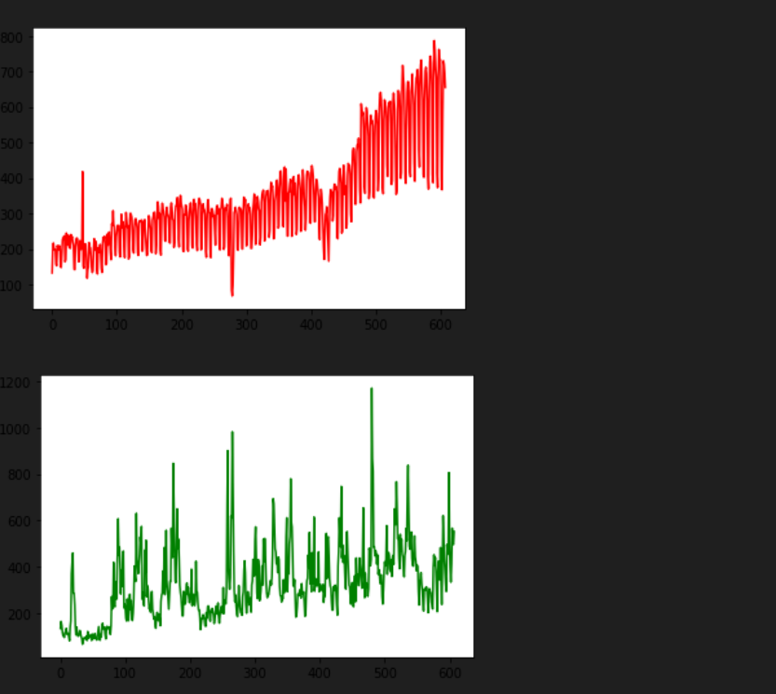
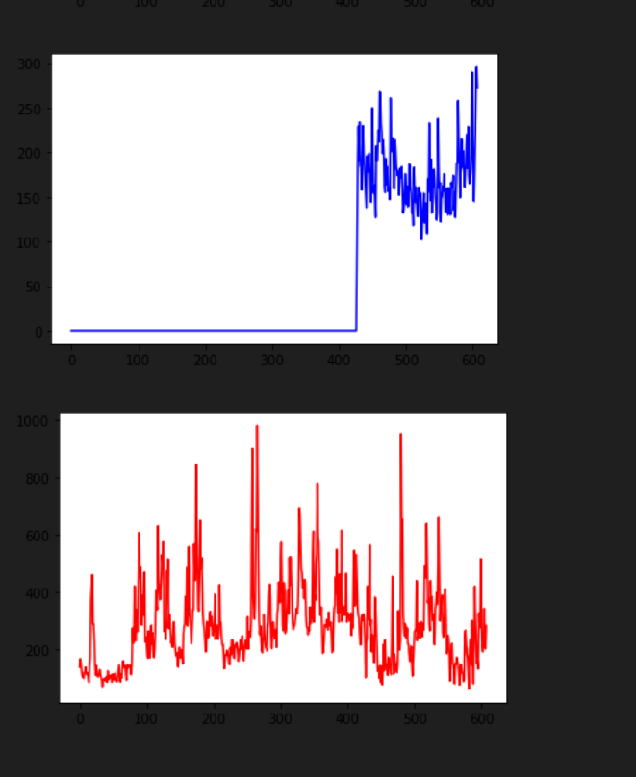

Slide 15
Durability:
• Issue: The system needs to be reliable and durable for long-term use.
• Solution: Conducted stress testing and ensured robust error handling mechanisms are in place.
Implemented regular model retraining to maintain performance over time. Power Consumption:
• Issue: The system should be energy-efficient, especially if deployed on edge devices.
• Solution: Used efficient algorithms and optimized the code to reduce power consumption. Considered deploying on energy-efficient hardware if needed.

Slide 16
Conclusion
In conclusion, our endeavor in forecasting smart city traffic patterns has not only delivered tangible benefits in terms of improved traffic management and urban planning but has also laid the foundation for a smarter, more connected city. By harnessing data-driven insights and fostering collaboration, we are committed to shaping a future where urban mobility is efficient, sustainable, and inclusive.
Impact on Urban Mobility: The implementation of forecasting models has positively impacted urban mobility. By anticipating traffic flows and congestion hotspots, we have enabled proactive measures to optimize traffic management and enhance commuter experiences.
Support for Infrastructure Planning: Our forecasts have informed infrastructure development and urban planning initiatives. By predicting future traffic demands, we have guided the expansion of road networks, public transit systems, and other critical infrastructure.
Continuous Improvement: The project highlighted the importance of continuous improvement and adaptation. Feedback loops and ongoing data analysis have allowed us to refine our models, ensuring they remain responsive to evolving city dynamics and user needs.

Slide 17
Future scope
While the project achieved significant milestones, there are several areas for future work that could further enhance the utility and robustness of the traffic pattern prediction model. Due to time constraints, some ideas and enhancements were not implemented but hold promise for future development:
• Deployment Using Flask
One of the major future enhancements would be to deploy the traffic prediction model using Flask. This would involve creating a web application that allows city planners and traffic management authorities to interact with the model in real-time. Key components of this future work include:
• User Interface (UI):
Develop a user-friendly interface where users can input parameters such as date, time, and specific junctions to get traffic predictions.
• API Development:
Create RESTful APIs using Flask to handle requests and responses between the user interface and the model.

Slide 18
• Real-Time Data Collection Currently,
the model is based on historical traffic data provided in the dataset. To enhance the accuracy and reliability of predictions, real-time data collection using actual sensors could be integrated. Future work in this area includes:
• Sensor Integration:
Deploy IoT sensors at various junctions to collect real-time traffic data, including vehicle counts, speeds, and congestion levels.
• Data Pipeline:
Establish a robust data pipeline to ingest, preprocess, and store real-time data from sensors. This could involve using cloud services for scalable data storage and processing.
• Model Retraining:
Implement mechanisms for continuous model retraining with the influx of realtime data to ensure that the model remains accurate and up-to-date with the latest traffic patterns.

Slide 19
• Advanced Modeling Techniques
Exploring more advanced modeling techniques and algorithms could further improve prediction accuracy. Some potential future enhancements include:
• Deep Learning Models:
Investigate the use of deep learning models such as Recurrent Neural Networks (RNNs) or Long Short-Term Memory (LSTM) networks, which are well-suited for timeseries prediction tasks.
• Ensemble Methods:
Combine multiple models, including LGBM, Random Forest, and deep learning models, in an ensemble approach to leverage the strengths of each model for better predictions.
. • Enhanced Data Visualization
Improving the visualization aspects of the project can provide more actionable insights to stakeholders. Future work could focus on:

Slide 20
References
https://www.uniconvergetech.in/
https://www.theiotacademy.co/
https://mail.edunetmail.com/

Slide 21
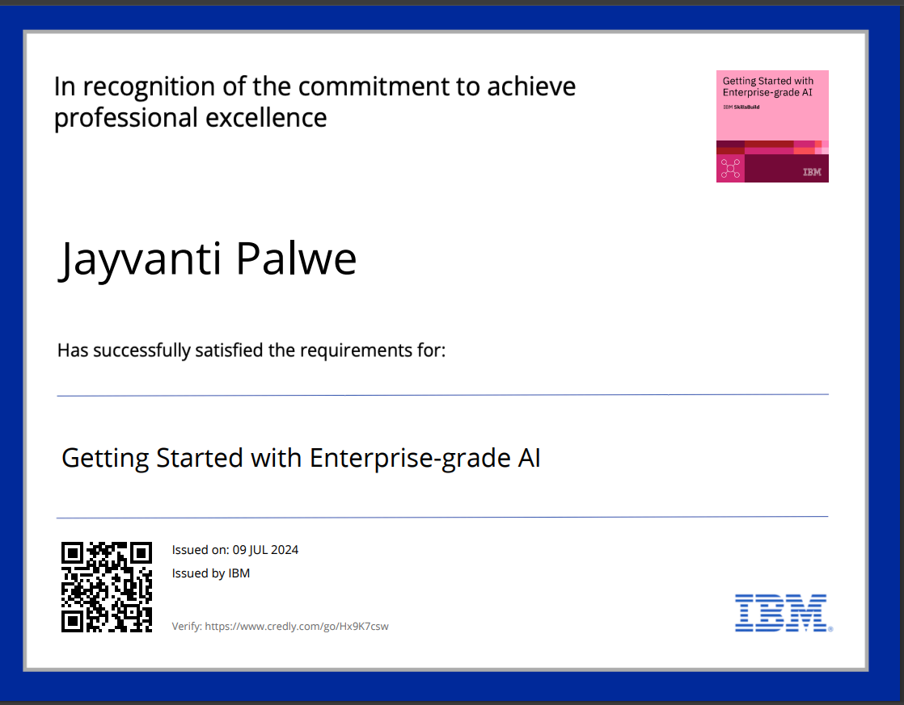
Certificate1

Slide 22

Cetificate 2

Slide 23
THANK YOU

